Slide 1
CS118: Lecture 3
George Varghese
Oct 2024
Making it real: More sophisticated clock recovery and types of media

Slide 2
Recall Lecture 1, Physical Layer
How to send bits over a wire, basic concepts
5

Slide 3
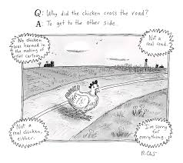
Why did the bit cross the wire?
But how did the bit cross the wire?
By hitching a ride on some energy
5

Slide 4
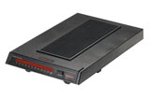
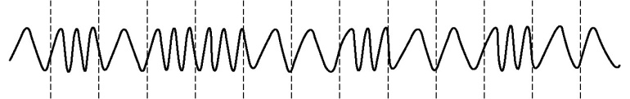
The Foundation: Sending Bits
A three-step process
Take an input stream of bits (digital data)
Modulate some physical media to send data (analog) that can travel distances
Demodulate the signal to retrieve bits (digital again)
Anybody heard of a modem (Modulator-demodulator)?
digital data (a string of symbols)
digital data (a string of symbols)
modulation
demodulation
a signal
0101100100100
0101100100100
Digital
Analog energy that can travel
Digital

Slide 5
What does the Physical Layer Do Abstractly?
RECEIVER 1
bits
SENDER
PHYSICAL LAYER
RECEIVER 2
RECEIVER N
A possibly faulty, single-hop, bit pipe that connects a sender to possibly multiple receivers
1

Slide 6
PHYSICAL LAYER: SUBLAYERS
Input Stream Output Stream 01010000 01010000
Coding Sublayer
Decoding Sublayer
Coded Stream
Coded Stream
Media Transmission
Media Reception
Sublayer
Sublayer
Input Signal
Output Signal
Signal Transmission Sublayer
(SHANNON AND NYQUIST LIMITS)
3

Slide 7
1.0 Bottom Sublayer: Signal Transmission and Limits
How fast can you send and what prevents you from sending faster?
5

Slide 8
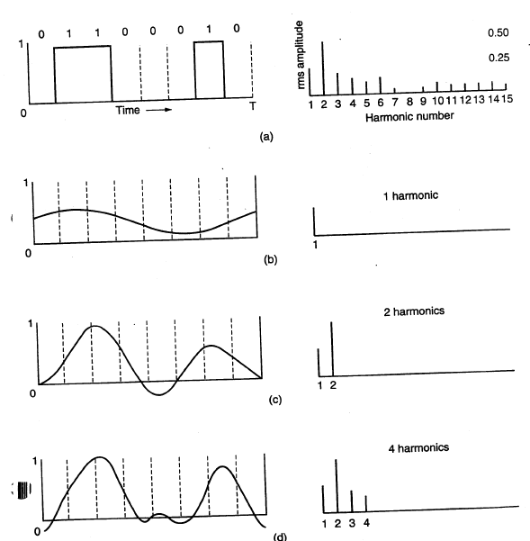
More bandwidth, better recovery of bits
ORIGINAL SIGNAL
FOURIER ANALYSIS

Slide 9
INPUT BIT
OUTPUT BIT
T
But Nyquist noticed that sending
Every T/2 also works because
peak of current lines up with
zeroes of past bits for sinc
Since bandwidth = 1/T, max bit
Rate = 2/T = 2 * bandwidth

Slide 10
THE SHANNON BOUND
Level 1
N N
Level 2
S
Level 3
Level 4
Level 5
S = Maximum Signal Amplitude
N = Maximum Noise Amplitude
log(S/2N) bits per signal
2 B signals/sec (Nyquist)
Naive Bound = 2 B log(S/2N)
Shannon Bound = B log(1 + S/2N)

Slide 11
2.0 Top Sublayer: Clock Recovery
How does a receiver know when to sample bits and how can the sender help?

Slide 12
Who needs a clock anyway?
 |  |  | 1 | 1 | 1 | 1
0 | 0 | 0
0 0
 |  | 1 | 1
0 | 0
0
How to initially synchronize receiver clock with sender clock? Initial Training Bits
Problem: All real physical clocks drift over time. Crucial at high speeds. Small drift leads to sampling error. How to keep in synch? Transitions

Slide 13
PHYSICAL LAYER: SUBLAYERS
Input Stream Output Stream 01010000 01010000
Coding Sublayer
Decoding Sublayer
THIS LECTURE
Coded Stream
Coded Stream
Media Transmission
Media Reception
Sublayer
Sublayer
Input Signal
THIS LECTURE
Output Signal
Signal Transmission Sublayer
(SHANNON AND NYQUIST LIMITS)
LAST LECTURE
3

Slide 14
Asynchronous Coding
START BIT
5−8 DATA BITS
PLUS PARITY
1−2 STOP BITS
IDEAL SAMPLING POINTS
Codes a character (5-7) bits at a time. ASCII. Adds parity bit.
Character is framed using a start bit and one or two stop bits. 1 is encoded as lowe voltage, 0 as high.

Slide 15
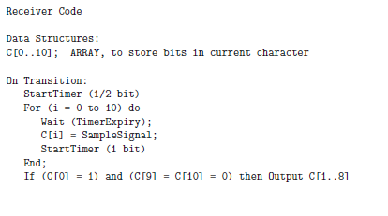

Slide 16
"SYNCHRONOUS" TRANSMISSION
Upto 12000 Bits
Lots of Start Bits (Preamble)
Lots of Stop Bits (Postamble)
same as asynchronous except
larger frame sizes . It requires better clock tolerance and more sophisticated coding.

Slide 17
Why Synchronous Transmission
For Clock Recovery, receiver must know when to start its receive clock (phase). Then can sample periodically at roughly sender clock with help from transitions in data.
In asynchronous, receiver gets locked in phase when the voltage goes from low to high (start bit). Need large idle time between to get locked in phase for each character; slows transmission and limits it to low rates.
Two overheads to start bits: extra bit but also extra time needed for reliable detection. (Starting up receiver clock is expensive)
In synchronous, we put a large number of start bits at the start of a large number of data bits amortizing startup overhead.

Slide 18
Manchester Encoding
Signal to Data
High to low transition ⇨ 1
Low to high transition ⇨ 0
Comments
Solves clock recovery problem
Only 50% efficient ( ½ bit per transition)
Still need preamble (typically 0101010101… trailing 11 in Ethernet)
Bits
0
0
1
0
1
1
1
1
0
1
0
0
0
0
1
0
NRZ
Clock
Manchester

Slide 19
Getting locked in phase
S1
S2
Time
In asynchronous you get in phase by a single 0 to 1 transition. Not very reliable in the presence of noise.
In Manchester, you get in phase by sending a preamble or group of start bits of the form 010101 in which the only transitions are at mid bit; easy to recognize and get locked in phase.

Slide 20
Better and Modern codes
Today almost no one uses Manchester because it has 50% overhead for a transition every bit. 1 bit is coded as 2 bits
More efficient to take a group of M bits and code it as N > M bits to guarantee a transition every N bits
Most common is 4-5 coding where M = 4 and N = 5. or 8-10 coding where M = 8 and N = 10.
Not so hard to implement because we can use table lookup for encoding and decoding
Homework 1, P2 is a clock recovery problem using 4-5 coding

Slide 21
Clarifications from Students
Edge Detector: A hardware gadget used to tell whether a 0 goes to a 1 or a 1 to a zero that we abstract as a function to tell where a transition is
Sample Signal: A hardware gadget that samples the wire and applies a threshold to get a 0 or a 1
Why 11 in Manchester: Because the receiver gets locked in after a variable number of preamble bits and so counting does not work, need a pattern in data

Slide 22
HOMEWORK QUESTION
Initialize
Clock = 0
lag = 0
P = 0
Main Loop
StartTimer(T/2)
Wait(TimerExpiry)
Do until end of frame
Output (Sample Signal) // Output Sampled value when timer expires)
P = P + T + lag
StartTimer (T + lag)
Wait(TimerExpiry)
In parallel with Wait look for Transition if any
If Transition is detected at actual time A
lag = A - P // difference between real and predicted
end

Slide 23
Reality: Phase Locked Loops
RECEIVER SAMPLING CLOCK
OBSERVED TRANSITIONS IN DATA
Once you lock in at the start of a data unit, you can rely on accuracy of receiver clock frequency (as in asynchronous). Can’t do that if data unit is large (as in synchronous).
Could try resetting receiver clock on every observed transition. Susceptible to noise (see HW). Better to use more gradual adjustment.
Phase Locked Loops measure phase difference and speed up or slow down receiver clock to reduce phase difference. Commonly used.

Slide 24
Broadband Coding
(So far) Baseband Coding using energy levels such as voltage or light. In broadband coding information is modulated on a carrier wave of a certain frequency. Used by modems.
Modulation refers to changing the properties of the carrier to convey the required information.
Frequency Shift Keying (FSK): high frequency encodes a 1 and low a 0, Amplitude Shift Keying (ASK): high amplitude encodes a 1. QAM (multiple amplitudes and phases)

Slide 25
Baseband versus Broadband
Baseband modulation: send the “bare” signal
E.g. +5 Volts for 1, -5 Volts for 0
All signals fall in the same frequency range
Broadband modulation
Use the signal to modulate a high frequency signal (carrier).
Can be viewed as the product of the two signals
Amplitude
Amplitude
Signal
Carrier
Frequency
Modulated
Carrier

Slide 26
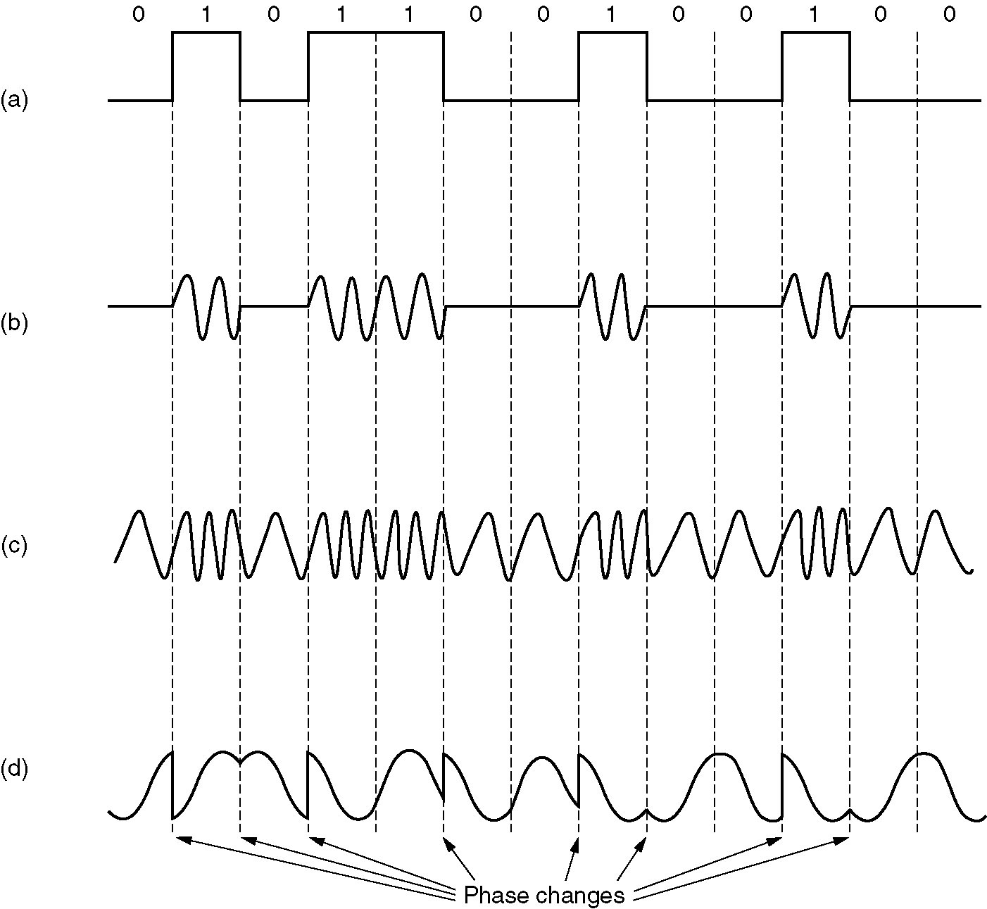
Digital Modulation Methods (from Tanenbaum)
Input Signal
Amplitude Shift Keying
(ASK)
Frequency Shift Keying
(FSK)
Phase Shift Keying
(PSK)

Slide 27
Three Levers for Modulation
FDMA
power
frequency
TDMA
time
power
frequency
CDMA
time
power
time
frequency
Courtesy Takashi Inoue

Slide 28
MULTIPLEXING (SHARING)
S1
S1
S2
S1 S2 S1 S2 . . .
S2
TIME DIVISION MULTIPLEXING (TDM)
S1
S1
S2
S2
FREQUENCY DIVISION MULTIPLEXING (FDM)
and Wavelength division multiplexing for fiber

Slide 29

3.0 Middle Sublayer: Media
What is best technology to convert bits to energy to travel distance?

Slide 30
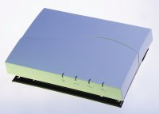
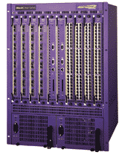
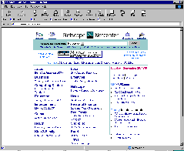
Sample Media at UCLA
802.11b Wireless
Access Point
2.4Ghz Radio
DS/FH Radio
(1-11Mbps)
Cat5 Cable (4 wires)
100Base TX Ethernet
100Mbps
Ethernet switch/router
To campus
backbone
62.5/125um 850nm MMF
1000BaseSX Ethernet
1000Mbps

Slide 31

Why Study Media
Media affects Protocol Design
Reinforced Concrete to Skyscrapers
We need to understand media tradeoffs when architecting networks
Think of flashlights versus semaphores

Slide 32
Media Affects Protocols
Low Bandwidth led to tight encoding:
Early Phone lines, not needed on LANs
Broadcast LANs led to use of Multicast:
Initialization and free copies, to IP multicast.
Building wiring led to Switching: Wiring closets to hubs to switches.
Fiber a game changer: Point-to-point fibers led to rings and then switches
Fiber changes telephony: Long haul telephone network becomes digital.
Wireless leads to low bandwidths again:
Laptops. Need Ipv6 compression on wireless!

Slide 33
TWISTED PAIR COPPER
CPU
CPU
MODEM
MODEM
UART
UART
Twisted Pair
RS−232
Low bandwidth
Cheap, Easy to Install

Slide 34
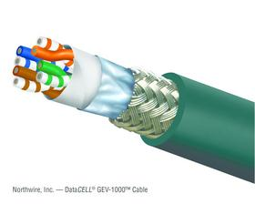
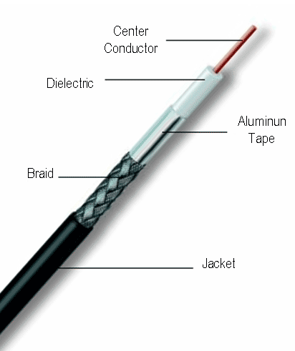
TWISTED PAIR INSIDER VIEW
Typical examples
Category 5/6 Twisted Pair 10M-10Gbps 50-100m
Coaxial Cable 10-100Mbps 200m
twisted pair
coaxial
cable
(coax)
copper core
insulation
braided outer conductor
outer insulation

Slide 35
Using Twisted Pair for Higher Rates Today
Standard twisted pair is limited by loading cables by telephone company to 4 Mhz. Shannon limit is around 56 Kbps (not counting compression). Two alternatives:
Better quality twisted pair cables for local area networks e.g., Cat 3 (10 Mbps, Manchester), Cat 5 (100 Mbps, 100 Mhz bandwidth uses 4-5 coding)
Telephone company removes loading cables, reduces your length, and gives you ADSL. Asymmetrical.

Slide 36
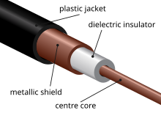
COAXIAL CABLE INSIDER VIEW

Slide 37
BASEBAND CABLE (e.g. ETHERNET)
CPU
Transceiver
Transceiver
CPU
Adaptor
Adaptor
Coaxial Cable
TERMINAL
CPU
High bandwidth (10−100 MHz)
Hard to tap,
Expensive to Install
Small Distance (1 − 3 km)

Slide 38
Using Coaxial Cable Today
Coaxial cable has high bandwidth. Used for original 10 Mbps Ethernet but very clunky. Twisted pair (e.g. Cat 5) used today.
Cable still used in cable networks for cable TV and for data via cable modems. Divide bandwidth into 6 Mhz channels for each TV channel and one 6 Mhz channel for downstream data. Theoretically can reach 30 Mbps but beware other users and bandwidth limits. Upstream much less.

Slide 39
FIBRE OPTICS
Slow Signal
Direct Signal
LED
Laser
Photodiode
Huge Bandwidth (10 Million Mhz!)
Almost Imposible to Tap Point−to−point Secure
Excellent Electrical Isolation
Thin and Easy to Install
Optics still expensive Unidirectional

Slide 40
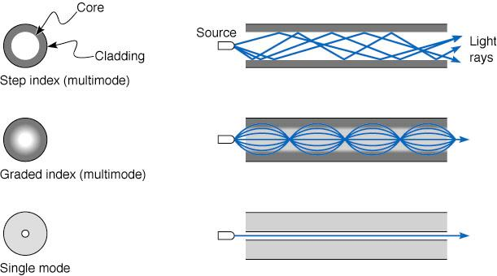
Fiber Optics: more physical view
Typical examples
Multimode Fiber 100Mbps-10Gb 500-2000m
Single Mode Fiber 1-100Gbps 100m-40km
Cheaper to drive
(LED vs laser) &
terminate
Longer distance
(low attenuation)
Higher data rates
(low dispersion)

Slide 41
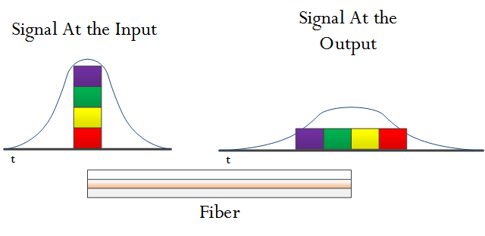
Chromatic Dispersion
Different lights go at different speeds through glass
Problem: spreads out signal at output. Can’t send next bit till output width or you get inter symbol interference (non –Nyquist related)
Solution: Use monochromatic light (lasers)

Slide 42
Wireless
Widely varying channel bandwidths/distances
Extremely vulnerable to noise and interference
Omnidirectional, goes through
Obstacles, lower speed
Directional, absorbed by
obstacles, higher speed
AM
FM
Twisted
Pair
Coax
Microwave
TV
Satellite
Fiber
Freq (Hz)
10⁴
10⁶
10⁸
10¹⁰
10¹²
10¹⁴
Radio
Microwave
IR
Light
UV

Slide 43
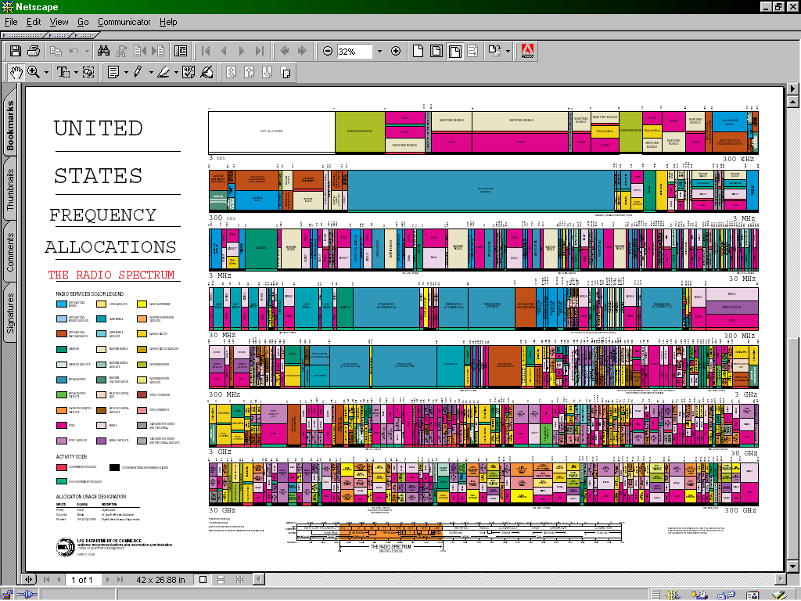
Spectrum Allocation
Policy approach forces spectrum to be allocated like a fixed spatial resource (e.g. land, disk space, etc)
Reality is that spectrum is time and power shared
Measurements show that fixed allocations are poorly utilized
Frequency (Hz)
Time (min)
Hot topic: Whitespace communication

Slide 44
MICROWAVE
CROWDED CITY
TOWER
TOWER
Avoids Right of Way
Cheaper than installing cable
Reasonable Bandwidth
Up to 100 km distance
Problems with Rain

Slide 45
SATELLITE
DISH
DISH
Avoids Right of Way
Good Bandwidth (500 Mhz) World Wide
Large Latency Expensive Antenna

Slide 46
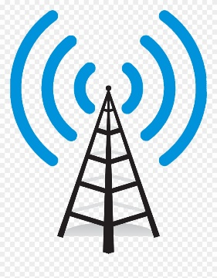

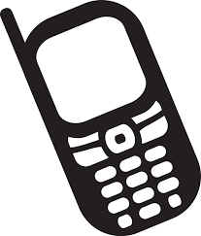
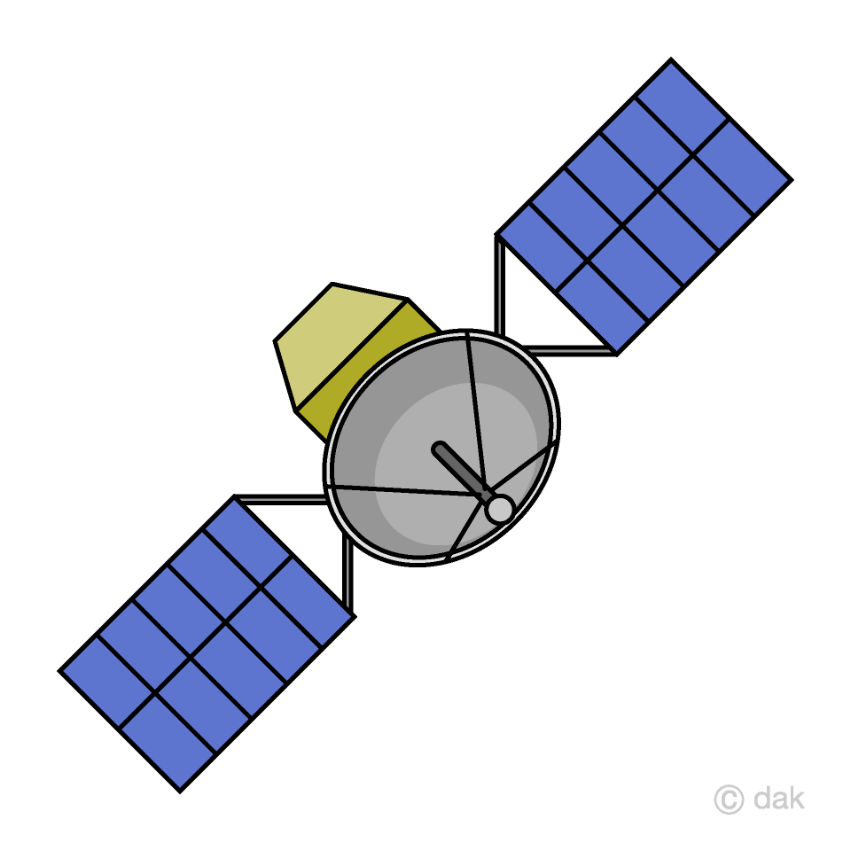
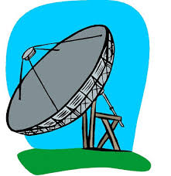
Low orbiting Satellites
Handoff
CELL PHONES: PEOPLE MOVE
Satellite D
Satellite A
Earth
Satellite D
Satellite B
Satellite C
LEO: “BASE STATION”MOVES

Slide 47
Wireless Data Options
802.11: Wireless LANs using a wireless access point (AP) at hot spot using unlicensed frequency band 2.4 to 4.485 Ghz (radio frequency) 100 metres. 11 Mbps with 802.11b. Needs hotspot but becoming common and very cheap!
Bluetooth: ad hoc personal area networks with no AP. Master-slave. 4 Mbps
WiMax: broader geographical range smaller bandwidth of a few Mbps
3 G (Cellular telephone networks carrying data) at a few Mbps such as EVDO. Unlimited geographical range and true mobility

Slide 48
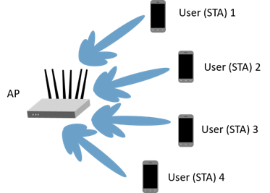
Basic Wireless: 802.11

Slide 49
802.11b in some more detail
AP configured with a SSID that you can see when doing View Available Networks and a channel number from 1 to 11. Non-overlapping channels (1 6, 11) can be used to triple bandwidth
Each AP periodically sends a beacon containg SSID.
Each mobile scans all 11 channels looking for beacons to get a list of networks. Some choice of AP and then mobile sets up an association
Access protocol to send data tricky because of hidden terminal problem. Mobile A can send to base station and so can Mobile B, but A and B cannot hear each other but can interfere at base station. Needs careful protocol design (later)

Slide 50
MEDIA PROS AND CONS
Medium | Speed | Distance Span | Pros | Cons
Twisted Pair | 1 Mps -1 G (Cat 1 – Cat 5) | 1 – 2 Km | Cheap, easy to install | Low distance
Digital Coax | 10-100 Mbps | 1- 2 km | broadcast | Hard to install in building
Analog Coax | 100-500 Mbps | 100 Km | Cable companies Use it now | Expensive amplifiers
Fiber | Terabits | 100 km | Security, low noise, BW | No broadcast, Needs digging
Microwave | 10-100 Mbps | 100 km | Bypass, no right Of way need | Fog outages
Satellite | 100-500 Mbps | worldwide | Cost independent of distance | 250 msec delay Antenna size
RF/Infrared | 1 – 100 Mbps, < 4 Mbps | 1 km 3 m | wireless | Obstacles for infrared

Slide 51
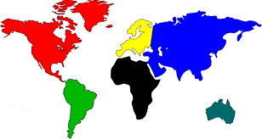


Crowded City Bottleneck,
Microwave, Radio
Trans-oceanic Bottleneck fiber, satellite
Last Mile
Bottleneck
Twisted Pair, cable, radio
PUMPING BITS GLOBALLY

Slide 52
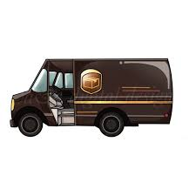
Prize Question
You are a genomicist in Broad in Bostom and want to get 1 Petabyte of genome data to Amazon in Seattle. What is the best way to do this?

Slide 53
ETHERNET SUBLAYERS
Input Bit Stream Output Bit Stream 01010000 01010000
Manchester
Decoding
Synchronous Coding
Coded Bit Stream
Coded Bit Stream
Media Transmission
Media Reception
Sublayer
Sublayer
Input Signal
Output Signal
MEDIA (COAXIAL CABLE)

Slide 54
Problems in all layers/systems
Resource Sharing: FDM/TDM
Addressing: TDM time slots
Synchronization: keeping state variables in synch: clock recovery, spacing apart levels.
Interconnection Physical layer repeaters are called hubs

Slide 55
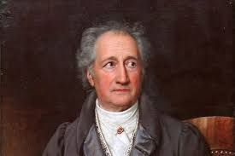
LECTURE 3 EPILOG: GOETHE ON STARTING
“Until one is committed, there is hesitancy, the chance to draw back — the moment one definitely commits oneself, then Providence moves too. . . .Whatever you can do, or dream you can do, begin it. Boldness has genius, power, and magic in it. Begin it now.“
~ often attributed to Goethe,

